Slide 1

BASIC ELECTRICAL AND ELECTRONICS ENGINEERING
Course Code: CSE1002
SCHOOL OF COMPUTER SCIENCE ENGINEERING AND APPLICATIONS
Mrunmayee Rahate
Assistant Professor, DYPIU

Slide 2
Module 2: Semiconductor Devices and Applications
Lecture 5: Zener Diode as a Voltage Regulator (No Load and Loaded Regulator)

Slide 3

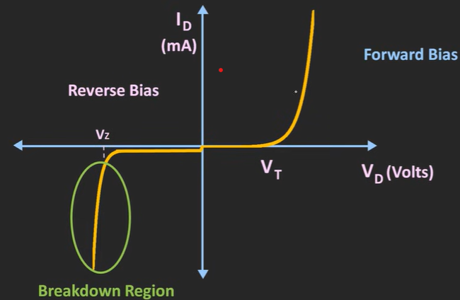
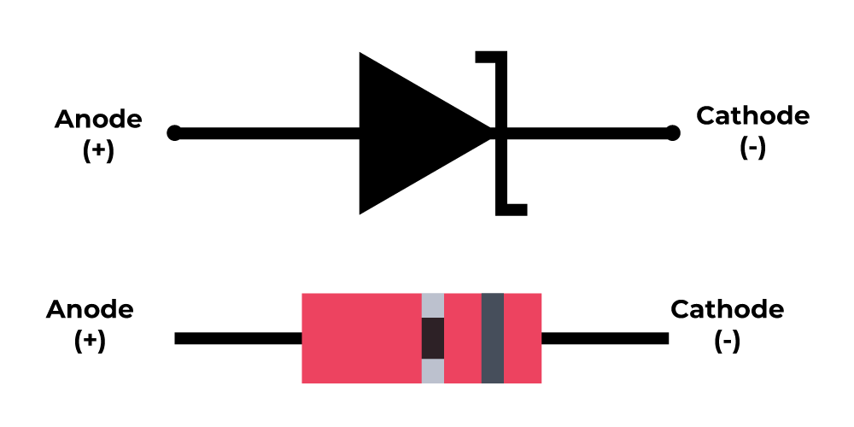
Zener Diode
They are special semiconductor devices that allow the current to flow in both forward and backward directions
For the Zener diode, the voltage drop across the diode is always constant irrespective of the applied voltage; thus, Zener diodes are used as a voltage regulator

Slide 4
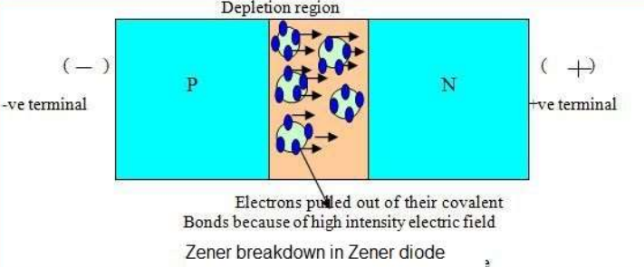
Zener breakdown
The Zener effect is a type of electrical breakdown in a reverse biased p-n diode in which the electric field enables tunnelling of electrons from the valence to the conduction band of a semiconductor, leading to a large number of free minority carriers, which suddenly increase the reverse current
Diode doping: Zener breakdown occurs in heavily doped diodes, which results in a very thin depletion region.
Mechanism: The high electric field across the thin depletion region is strong enough to break covalent bonds and pull electrons through the barrier via quantum tunneling. This is different from avalanche breakdown.
Voltage: It occurs at a relatively low reverse voltage, typically below 5V.
Control: The breakdown is a controlled effect, allowing the diode to be used for specific purposes without being destroyed, as long as current is limited to prevent heat damage.
Application: Zener diodes use this effect to maintain a stable voltage, effectively acting as a voltage regulator or a voltage clamp to protect other components

Slide 5
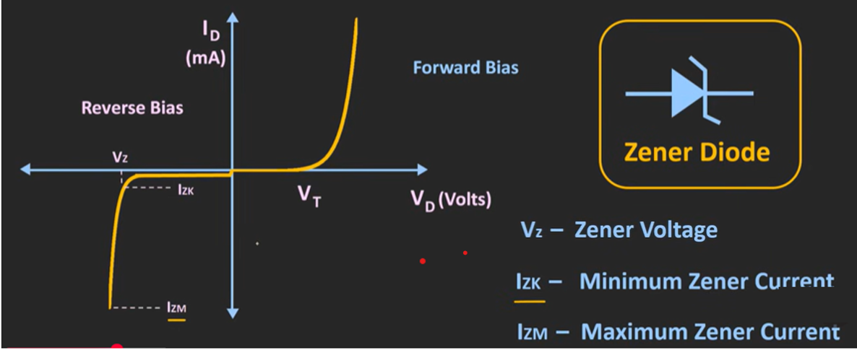
Zener Diode Characteristics
A Zener diode's current range, from a minimum to a maximum value, is necessary to maintain a stable breakdown voltage for applications like voltage regulation
The minimum current, also called as the knee current, (IZK) is required to keep the diode in its operating breakdown region, while the maximum current (IZM) is the upper limit to prevent the diode from overheating and being destroyed by excessive power dissipation

Slide 6
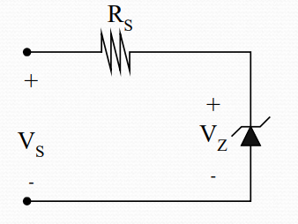
Zener Diode as a regulator – No load condition
In both no-load and full-load conditions, the Zener diode acts as a voltage regulator by maintaining a constant voltage (Vz) across itself and the load, as long as the input voltage is within limits and the diode is in its breakdown region
A Zener diode acts as a voltage regulator (No Load Condition) by connecting it in reverse bias with a series resistor (Rs) to limit the current
Stable output voltage: When there is no load, the entire current from the input source flows through the Zener diode. After dropping the excess voltage across the series resistor (Varies to compensate for the changes in the applied input voltage), the voltage across the load remains stable at Vz.
Operating limits: The regulation only works as long as the input voltage is greater than the Zener voltage (Vz) and the current through the diode stays within its operating range (IzK - IzM)

Slide 7
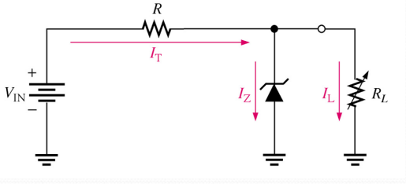
Zener Diode as a regulator – Loaded condition
A Zener diode acts as a voltage regulator (Loaded Condition) by connecting it in reverse bias across a load (RL), with a series resistor (Rs) to limit current
Stable output voltage: When a load is connected, the load draws a current, which causes the Zener diode to draw less current. The Zener diode compensates by allowing less current to flow through itself. If the load resistance (RL) increases (or decreases), the load current decreases (increases). The Zener diode compensates by allowing more (or less) current to flow through itself, maintaining the constant voltage drop across the load.
Operating limits: The regulation only works as long as the input voltage is greater than the Zener voltage (Vz) and the current through the diode stays within its operating range (IzK - IzM)

Slide 8
Thank You !!!

